Slide 1
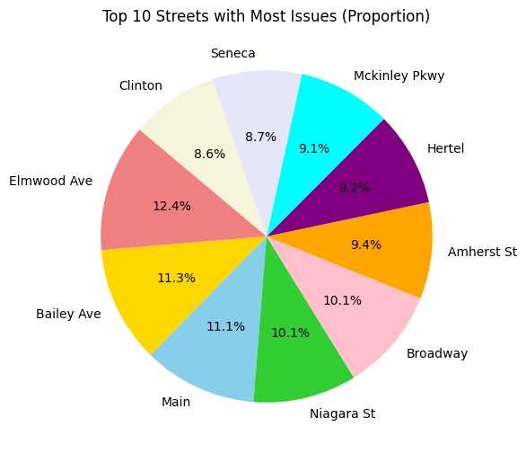
Buffalo 311 Service Analysis: Most Reported Issues May 11 – August 20, 2024
CIS 461

Slide 2
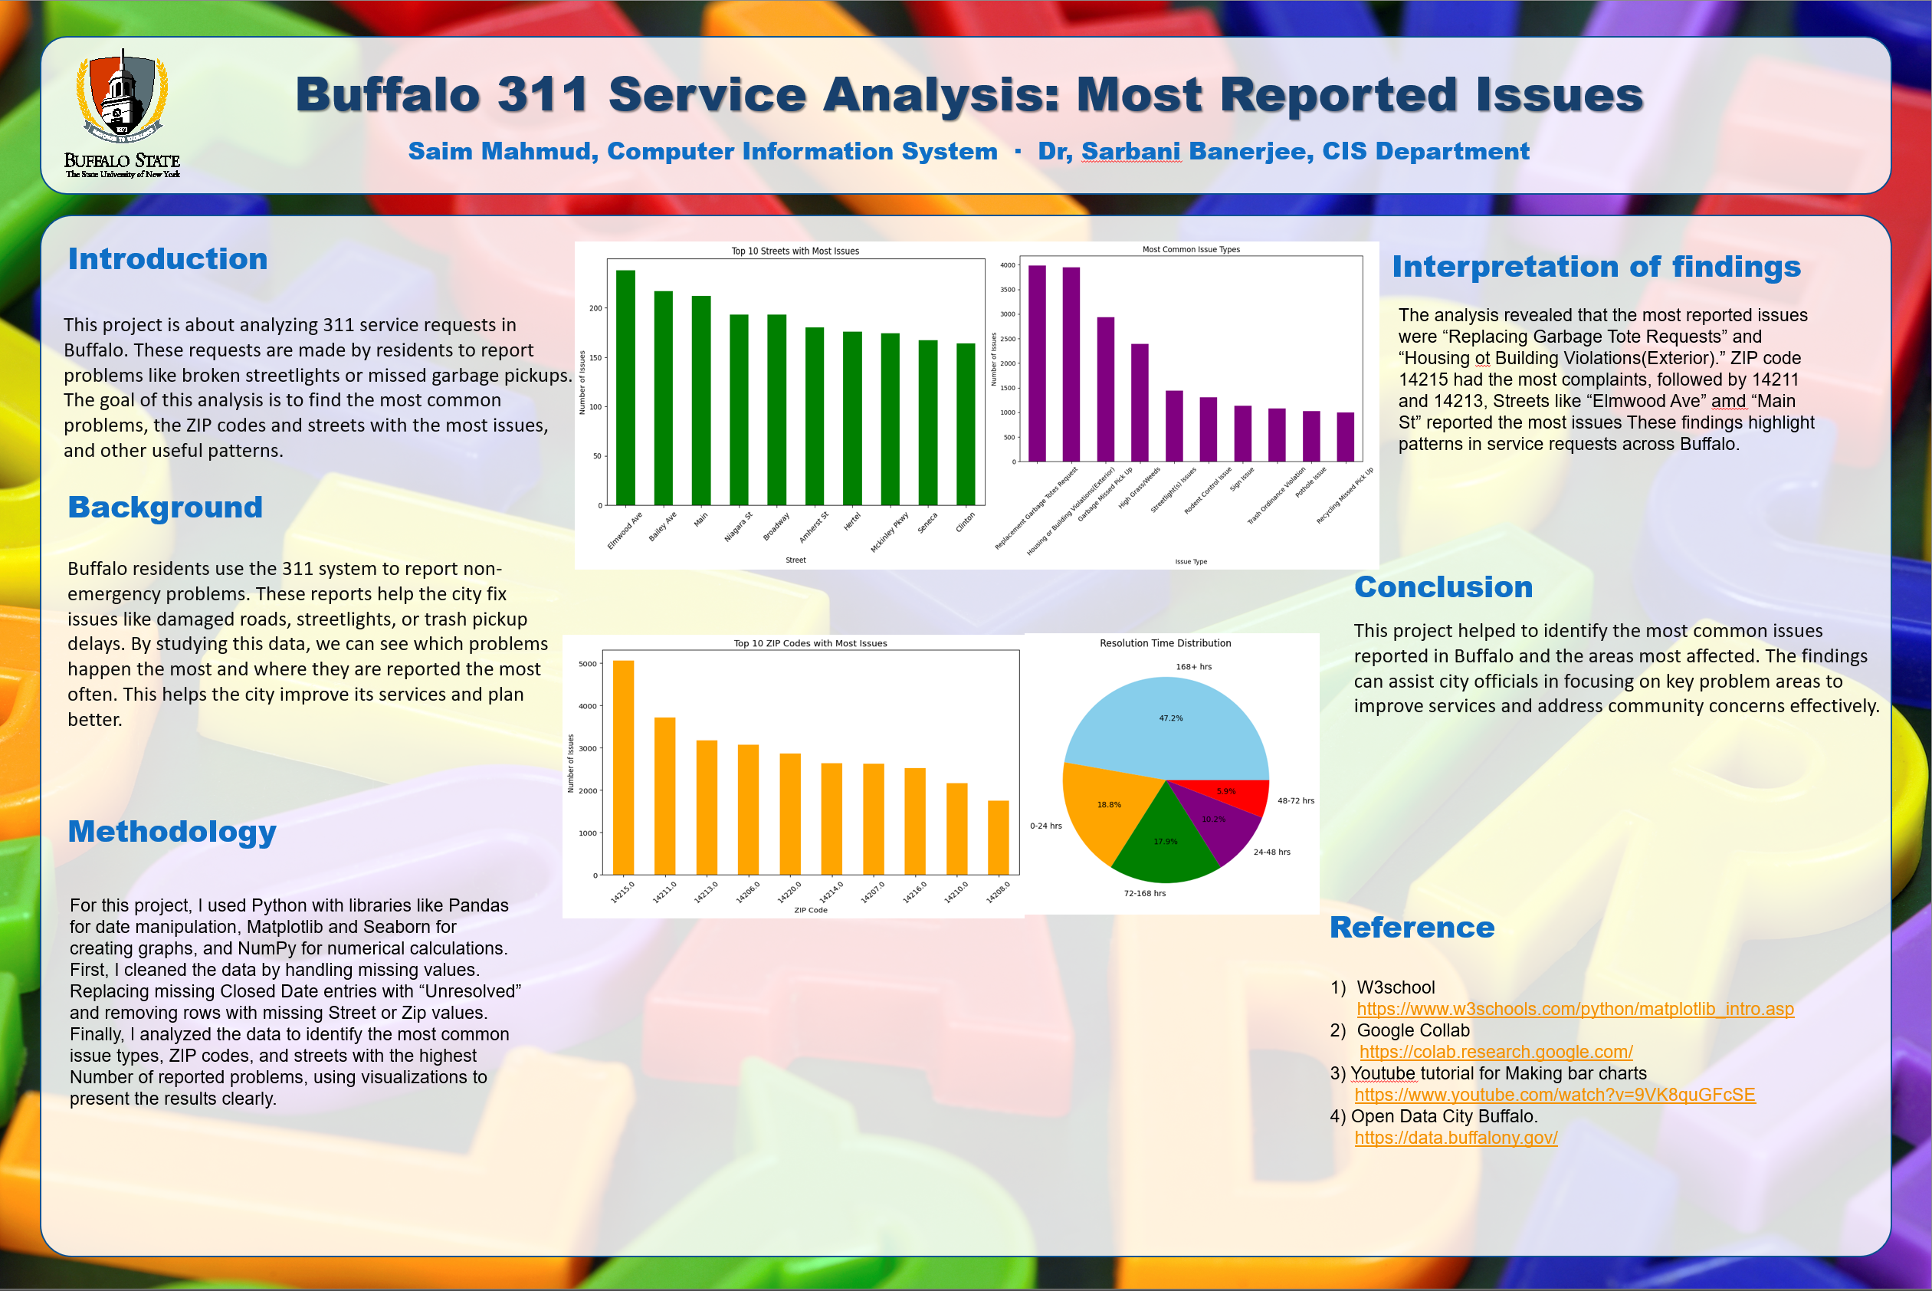

Slide 3



What I used
Google Colab
CsvFile
W3school

Slide 4
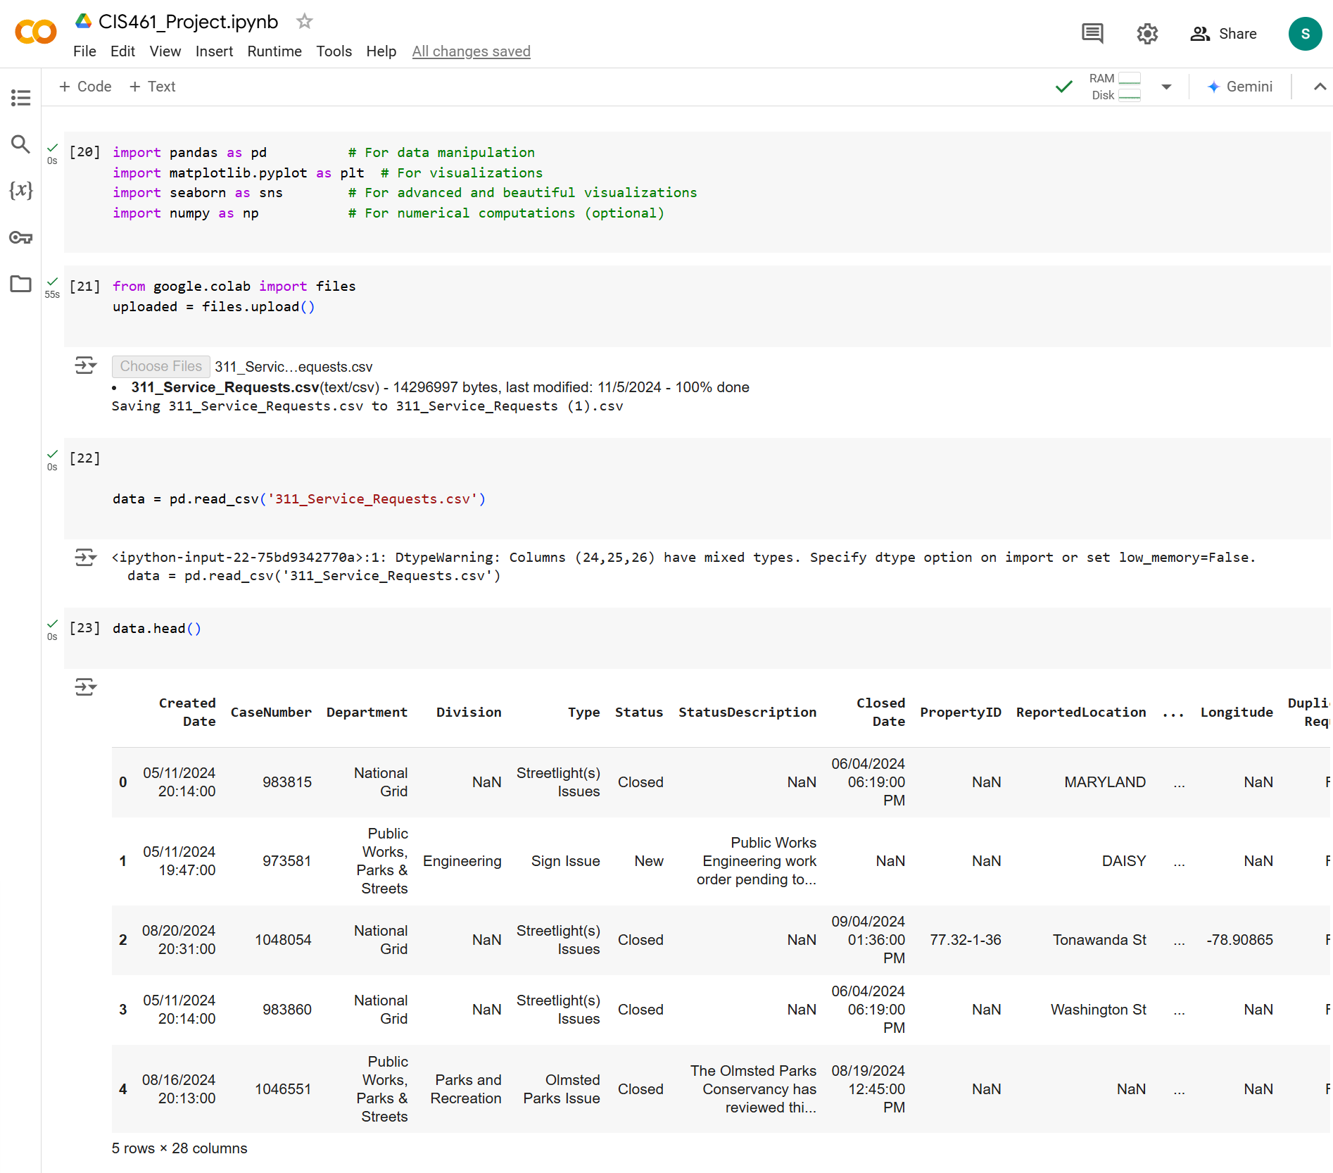
Import the CSV file
Notes:
Pandas: used for data manipulation and analysis, It helped in loading, cleaning, and preparing the dataset for analysis.
Matplotlib: to create bar charts and histograms to visualize the findings
NumPy: NumPy is a library for numerical computations.

Slide 5
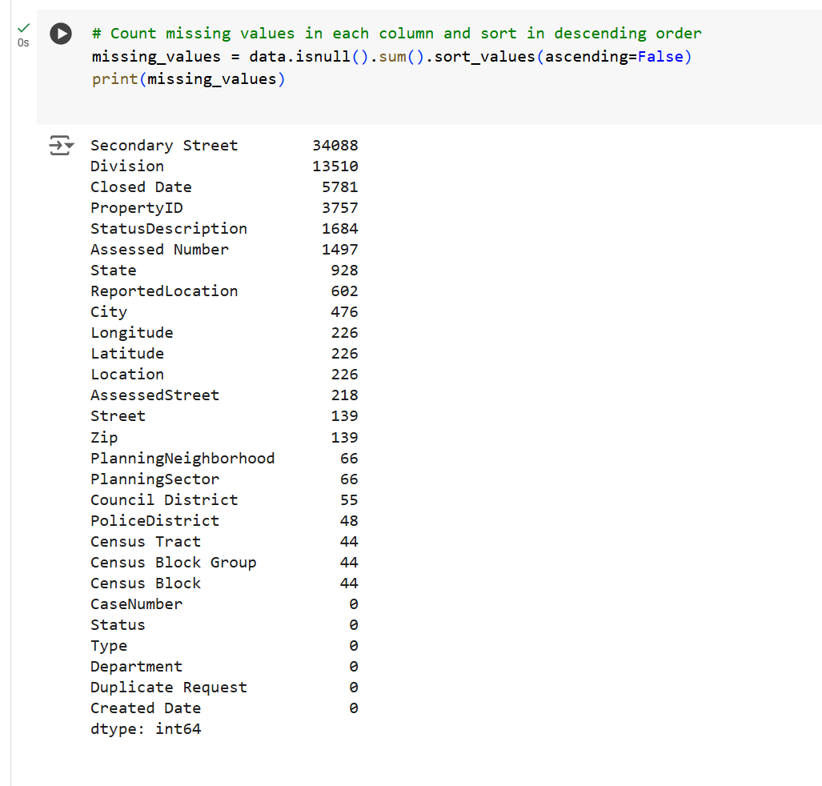
Finding column with Missing Value
Notes:
data.isnull(): This function checks each cell in the dataset to see if it contains a missing value
.sum(): Summarizes the total number of missing values for each column.
.sort_values(ascending=False): Sorts the columns in descending order based on the number of missing values,
print(missing_values): Displays the sorted result, showing the count of missing values for each column

Slide 6
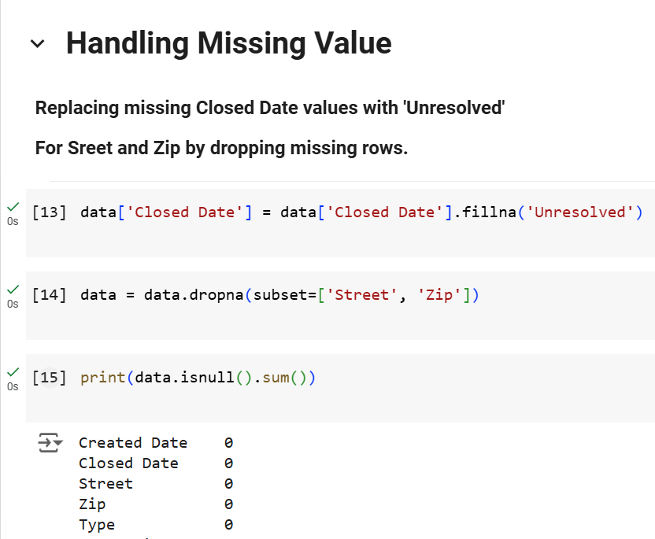
Handling Missing Value
Notes:
In this dataset, there were many columns available, but I selected only the most relevant ones for my analysis based on the project goals and requirements.
Replace Missing 'Closed Date': The fillna('Unresolved') method is used to fill missing values in the 'Closed Date' column with the string 'Unresolved'. This ensures no data is left as missing while keeping track of unresolved cases.
Drop Missing Rows for 'Street' and 'Zip': The dropna(subset=['Street', 'Zip']) method removes rows where either 'Street' or 'Zip' values are missing
Verify Cleanup: The data.isnull().sum() method is used to confirm that there are no remaining missing values in the key columns.

Slide 7
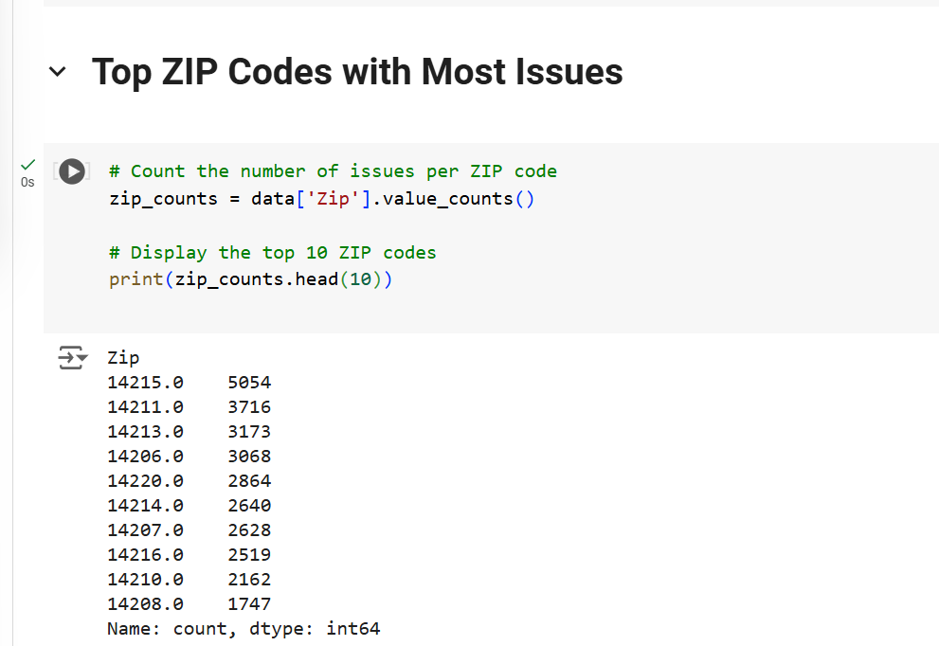
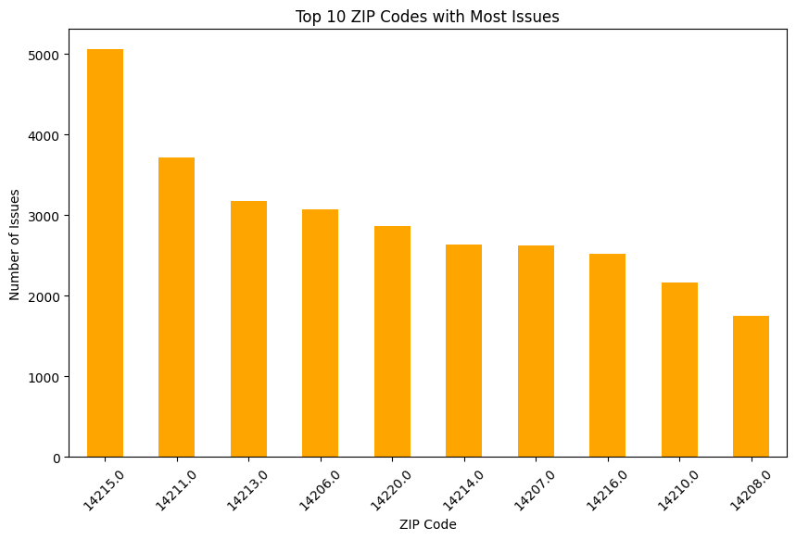
Top ZIP Codes with Most Issues
Notes:
data['Zip'].value_counts(): This calculates the number of occurrences (or issues) for each ZIP .head(10): Extracts the top 10 ZIP codes with the most issues for better visualization.
print(zip_counts.head(10)): Displays the result, showing the ZIP codes alongside the count of issues.

Slide 8
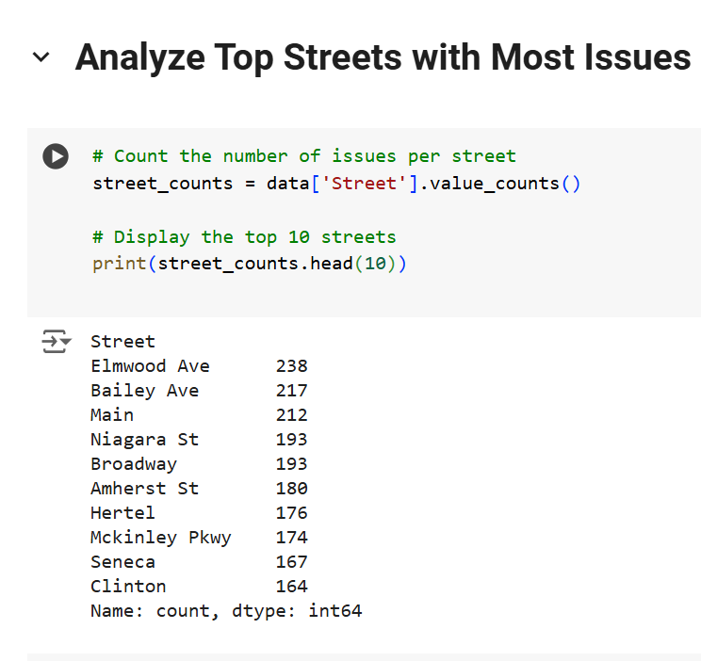
Analyze Top Streets with Most issues

Slide 9
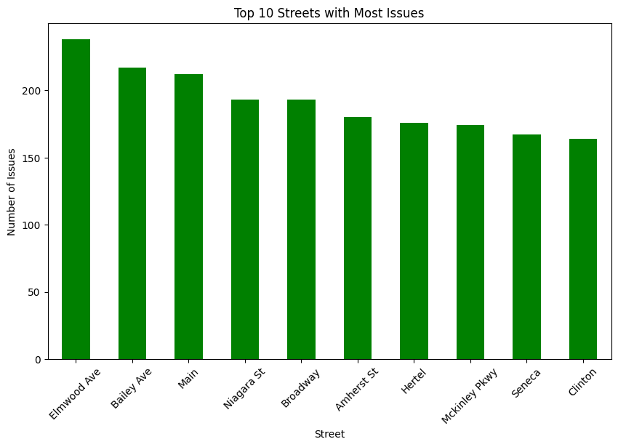

Slide 10
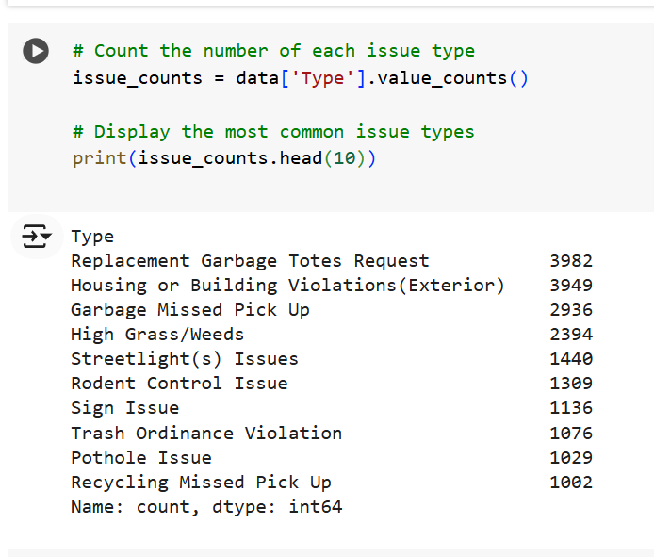
Analyze Most Common Issue Types
Notes:
data['Type'].value_counts(): This counts the occurrences of each type of issue in the dataset.
.head(10): Retrieves the top 10 most frequent issue types.
print(issue_counts.head(10)): Displays the results, showing the issue types and their corresponding counts.

Slide 11
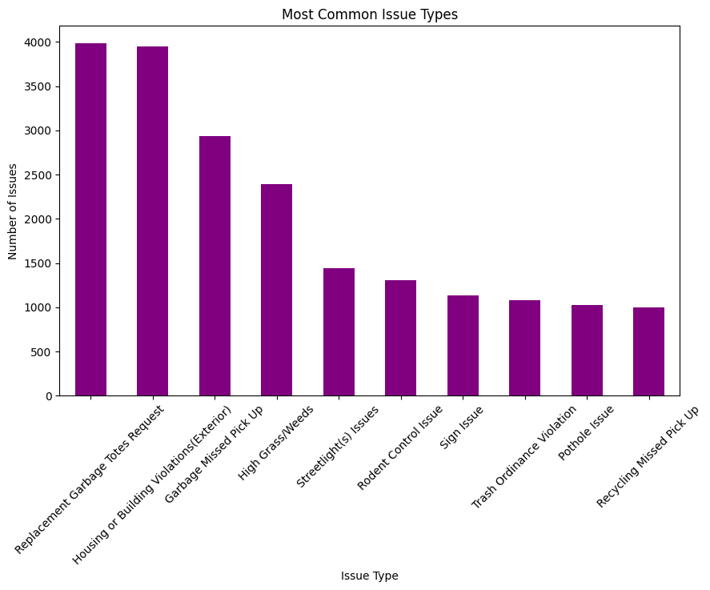

Slide 12
THANK YOU

